Slide 1
Week 1- Effective Communication
ICDT 1016Y

Slide 2
Important NOTES
Course Materials
Lectures/Labs and any notice/announcement will be available on Google Classroom
Class ID: tulzkdy
Access using umail address

Slide 3
Important NOTES
Attendance
Students SHOULD be present and participate in ALL Lectures and Class Activities
100% accounted as Coursework (Test, Assignment and Class Activities, Portfolio)
NO EXAM (Good news! But if you fail the module, you have to take it again the following year!)

Slide 4
Learning Outcome
After In this lecture you will be able to:
Understand and explain what communication is
Identify the various benefits of effective communication and also how to ensure good communication
Group the various methods of communication
Elaborate on the Communication Process
Identify the barriers to effective communication
Understand how culture impacts on communication

Slide 5
What is communication?
Communication is the art and process of sharing information and ideas.
It may be defined as :
“giving, receiving or exchanging information, opinions and ideas by writing, speech or visual means so that the message communicated is completely understood by recipient(s)”
Key to effective communication: make sure that the message is well delivered

Slide 6
Benefits of Effective Communication
Stronger decision-making and problem-solving
Upturn in productivity
Convincing and compelling corporate materials
Clearer, more streamline workflow
Enhanced professional image
Sound business relationships
Successful response ensured

Slide 7
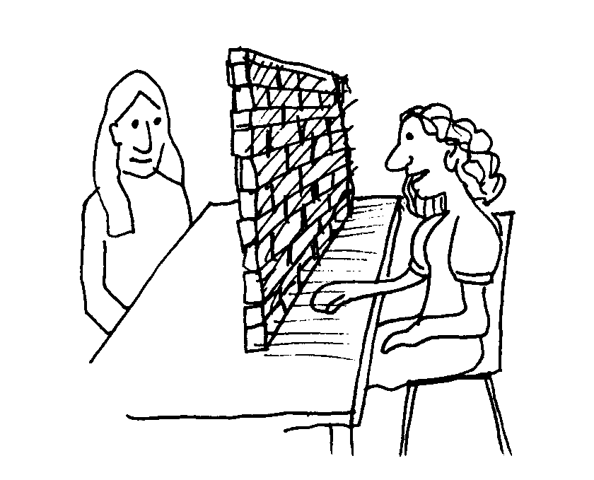
Communication Skills
Imagine the person you want to talk to is on the other side of the wall
How do you communicate??
You need to find the appropriate way to communicate i.e. You need to have the appropriate communication skills
Good communication skills allows you to :
Identify the barriers
Receive message well
Use the required methods to remove the barriers and communicate your message

Slide 8
Effective Communication is vital to meet challenges like
Advancing Technology
Internet, Email,Fax, VoiceMail, Teleconferencing, VideoConferencing, Wireless devices e.g. Smartphone
Global Communications
Multinational companies e.g. Accenture, Ceridian
Different cultural backgrounds
The Information Age
Quick and effective decision based on the information you receive
Team-based business environments
No longer traditional management hierarchy, need to study and understand how team work

Slide 9
Methods of Communication
Report
Telephone
Memo
Memo
Graph/Charts
Messages
Intercom
Staff Newsletter
Email
WRITTEN
ORAL
INTERNAL
Communication
Fax
Minutes
Face-to-face discussion
Meeting/ Conference
Notice
Form/Questionnaire
Presentation
Intranet
INTERNAL COMMUNICATION

Slide 10
Methods of Communication
Telephone
Conversation
Teleconference
Conference/Seminars
Videoconference
ORAL
Meeting
Presentation
EXTERNAL
Communication
Internet
WRITTEN
Leaflet/Brochure
Letter
Invitation
Fax
Forms/Questionnaires
Email
Press Release
Report
Customer Newsletter
Graph/Chart
Advertisement
Notice
EXTERNAL COMMUNICATION

Slide 11
Question
How many of these forms of communication have you experienced with so far?

Slide 12
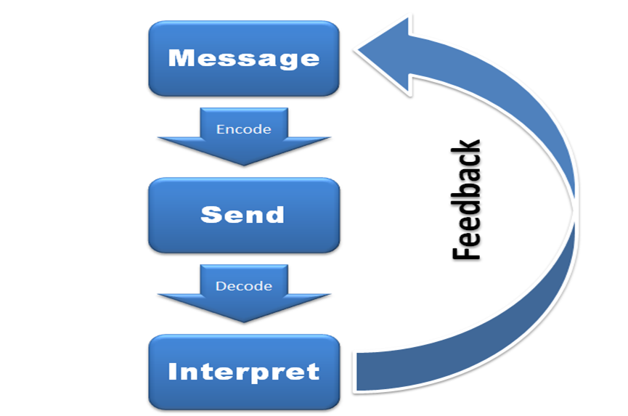
Communication Cycle

Slide 13
Communication Process
Involves multiple parts and stages which are as follows:
Source (Sender)
Message
Encoding
Channel
Decoding
Receiver
Feedback
Context

Slide 14
Communication Process(1)
Source
Sender is the source
Should be clear about the message being sent
Ask the following questions
Do you know exactly what you want to communicate?
Are you sure why you want to communicate a particular message?
What result do you expect?
If you don’t have the answer to these questions then there is a high chance that the communication process will fail.

Slide 15
Communication Process(2)
Message
Information we want to communicate
If cannot summarise information we need to share then we are not ready to start the communication process
Encoding
Process of taking a message and putting it in the format that can be shared with another party.
Before encoding, think about the other party.
Should be in a format that can be understood and decoded by the other party

Slide 16
Communication Process(3)
Channel
Method of communication that you choose
Depends on message
Can be face-to-face, by phone or by email

Slide 17
Choosing the channel of communication(1)
Cost
How much communication costs in terms of expected results
Can internal message be handwritten or is printing important?
Can email be considered instead of postal service
Confidentiality
Email or fax may not be appropriate
Telephone call may be overheard
Internal memo need to enclosed in an envelope
Safety and security
Should special PO service be used e.g. registered letter or recorded delivery
Is courier justified?
Influence
How to convey certain impression and image? E.g. Multicolored letterheads on high quality paper

Slide 18
Choosing the channel of communication(2)
Urgency
Produce desired results in the available time
Distance
Is communication within same building, town or other side of the world?
Time of Day
Important specially when communicating overseas
Resources
Equipment and Staff available (sender and recipient)
Written Record
More authority and proof of transaction
Recipient
Who is sending and receiving message
Personal contact may sometimes be more appropriate
Verbal communication may not be appropriate where complex information or bad news is concerned
Choose language appropriately, consider the situation, and the relationship between sender/recipient.

Slide 19
When use oral channels?
Message is fairly simple
Immediate response required
Permanent record not needed
Encourage interaction
Need to read body language
Need to hear tone
Message has emotional factor

Slide 20
When use written channels?
Message is fairly detailed and requires careful planning
Immediate response not required
Permanent written record required
Big, widespread audience
Minimise distortion that occurs when messages are passed orally from person to person
Immediate interaction with audience not needed
No emotional factor

Slide 21
When use electronic channels?
Speed is important
Time zone differs
Physically separated from your audience

Slide 22
Communication Process(4)
Decoding
Happens when you receive the message
Include ability to read, comprehend, listen actively, or ask for clarifications
May need to resend message in a different way or assist in understanding it if the person cannot decode the message
Receiver
Think about the desired result
Each person will be listening through his individual expectations, opinions and perspectives
Individual experiences will influence how the message is received

Slide 23
Communication Process(5)
Feedback
Helps to determine how successful communication was
Face-to-face communication : Read body language and ask question
Communication in writing: Gauge success by response obtained or see whether result you wanted is delivered
Context
Situation in which you are communicating
Environment, audience, culture, relationship between you and audience
The way you communicate with a friend is different from the way you communicate with your boss

Slide 24
Barriers to Communication
Non-verbal signals
Not understanding these signal can cause the communication to fail
Language
Many words have different meaning,
Background knowledge and experience affect our understanding
Foreign language, dialects, regional accents and use of technical/specialist language
Listening
Listening is a skill, careful concentration is demanded if communication is to be understood
Pre-judgement
What we understand is often conditioned with what we already know and by background knowledge and experience

Slide 25
Barriers to Communication(2)
Relationships
Effectiveness of communication will depend on relationship we have with the person
If relationship not good then communication may fail
Emotional responses
If person is highly emotional about the topic, this will impact on the communication
Problems may arise from insecurity, fear, anger
Systems
Prescribed procedures should be in place for getting messages to the people

Slide 26
Communication in organisations
Vertical Communication
Most frequent form of communication
CEO to all employees, HoD to all employees of the department
Follows ‘chain of command’ i.e. reporting lines that are reflected in the organisation
Downwards and Upwards communication
Horizontal Communication
Same status – sales staff, departmental heads, directors, supervisors
Same department of different departments
Face-to-face discussions, phone, correspondence

Slide 27
Communication in organisations(2)
Diagonal Communication
Between different people in different departments at different levels of the organisations
Tasks involve people from different departments
Involves committees, teams or task forces that are created to solve problems or complete special projects
Relies largely on cooperation, goodwill and respect between parties
Grapevine
Unofficial communication which is constantly changing
Vehicle for distortion of truth, rumour and gossip
Can cause damage by spreading incomplete, false or exaggerated information
May result to low morale, cynicism, fear and an unsettled workforce

Slide 28
Culture
For communication to be effective it is important to be aware of the cultural differences and be sensitive to it
What is culture?
Shared system of beliefs, values, expectations and norms and behaviour
Members of same culture have same beliefs and their theories of how people should behave – act based on these beliefs
Culture differs extensively
When you communicate you use your beliefs and theories.
What happens if the person with whom you communicate is not of the same culture ?

Slide 29
Acknowledging cultural differences
We assume that other people have the same attitude and lives as ours
Aim: Try to treat people not in a way you wish but rather treat them as they want to be treated
Do not judge other people by your own standards
Stay open minded
Avoid Ethnocentrism i.e. Do not hold the Belief that own’s culture is superior
To avoid ethnocentrism
Recognise differences
Avoid assumptions
Do not pre-judge

Slide 30
Checklist for communicating effectively
Show Respect
Show Empathy
Do not pre-judge
Be open-minded
Avoid distractions
Be patient
Look for similarities
Send clear messages
Recognise your prejudices
Treat people as equal

Slide 31
Seven steps to effective communication
Step1: What and why?
What is objective of your communication?
Why you have to communicate the message?
Aiming to give information, persuade, request and inform
Step2: Select Channel
Choose appropriate channel
Consider relationship between the sender and recipient
Consider background knowledge, culture and experience
Step3: Select encoding technique
Choose the Manner e.g. language, angry and soft voice, harsh tone or courteous tone
Why communication is happening e.g. is it urgent, dangerous, emotive, informative

Slide 32
Seven steps to effective communication
Step4: Consider Barriers
Consider all possible barriers may influence the recipients
Is communication likely to achieve the desired aims in the given circumstances?
If barrier are likely to interfere with the recipient’s understanding you may need to return to step 1 or 2
Step5: Send message
Having considered all these aspects, you may now send your message
Step6: Check for understanding
After sending the message, it is important to check whether the recipient has understood the message as you intended

Slide 33
Seven steps to effective communication
Final stage is essential - must obtained feedback from recipient
If the message is not understood, do not blame the recipient
Ask yourself why the communication failed
How it can be improved?
Step7: Feedback

Slide 34
Successful communication – key points to remember
Read. Extend your knowledge of language by reading
Listen intelligently. Remember that communication in a two-way process.
Think and Plan. Think before you speak or write. Plan all your communication.
Use appropriate language. Use clear, simple language, and appreciate the same used by others
Be open-minded. Use clear, simple language and appreciate the same used by others
Select appropriate media. Consider carefully the method to be used for communicating the message. It should be appropriate

Slide 35
Successful communication – key points to remember
Time your communication appropriately. Consider the best time for communication and how long it should be
Use appropriate language. Use words which are relevant to the topic and which will be understood by the recipient
Obtain feedback. Get feedback to ensure that the communication is effective
Aim high. Set and maintain high standards in all your methods of communication, both in terms of language and presentation.

Slide 36
Help Yourself
Ten years have ………….. since the two companies merged(past/passed).
When you take a problem to your manager, be sure to offer a …………………….. solution(alternate/alternative).
Good teachers should try to ………………………. Answers from their students, rather than telling them everything (illicit/elicit).
Perhaps you can ask the chairman to ………………………… the decision until the next meeting(defer/deter).
When the company received a lot of adverse publicity, the staff ………. was very low (moral/morale).
Always …………… that you proofread your documents carefully before sending them out. (insure/ensure)

Slide 37
Help Yourself
I have asked Martha to write ………….. to John Lim giving him a disciplinary warning (formally/formerly)
Mark has always ……………….. to being manager of his own company (aspired/inspired)
The CEO’s speech has a great ……………… on staff motivation. (affect/effect)
Please let me have your expert ………………… on this issue. (advice/advise)

Slide 38
Help Yourself
Ten years have ………….. since the two companies merged(past/passed).
When you take a problem to your manager, be sure to offer a …………………….. solution(alternate/alternative).
Good teachers should try to ………………………. answers from their students, rather than telling them everything (illicit/elicit).
Perhaps you can ask the chairman to ………………………… the decision until the next meeting(defer/deter).
When the company received a lot of adverse publicity, the staff ………. was very low (moral/morale).
Always …………… that you proofread your documents carefully before sending them out. (insure/ensure)

Slide 39
Help Yourself
I have asked Martha to write ………….. to John Lim giving him a disciplinary warning (formally/formerly)
Mark has always ……………….. to being manager of his own company (aspired/inspired)
The CEO’s speech has a great ……………… on staff motivation. (affect/effect)
Please let me have your expert ………………… on this issue. (advice/advise)

Slide 40
Test Yourself
Why is communication the lifeblood of a business organization?
( required for smooth running of the business, if people do not communicate the organisation will not even exists )
How do you benefit from effective communication?
(slide 4 considering someone working in an organisation)
Explain three of the factors you would consider when choosing a method of communication. (audience, type of message, cost, urgency)
Discuss three reasons why you would use a) oral channels of communication b) written channels of communication (slide 17-18)
What are the barriers of communication? Discuss briefly. (slide 22-23)
Discuss some ways in which you can improve intercultural communications. (slide 28)

Slide 41
Test Yourself
7. State the communication methods you would use to:
Congratulate an employee on passing an important examination
Inform employees about your annual dinner and dance.
Put a nervous applicant at ease while waiting for an interview.
Display the past five years’ sales figures.
Confirm a lunch appointment with a client next week.

Slide 42
What you have learnt?
In this lecture you have learnt about :
Basics of communication
Benefits of effective communication
Methods of communication
Communication Process
Barriers to effective communication
Culture and communication
7 steps to effective communication

Slide 43
References
TAYLOR, S., 2005, Communication for Business – A Practical Approach , 4th ed. Harlow:Longman
SPIERS C., 2011, Essential Communication Secrets, Available from: www.bookboon.com, [Accessed 01-August-2013]

